Slide 1

Disney Entertainment Television
R Scripts to Databricks: Lessons in Production Workflow
Eric Leung
Data Scientist – Content Analytics
Tuesday August 13th, 2024

Slide 2





Live TV Watching Households
Live TV + Ads

Slide 3



Live TV Watching Households
Live TV + Ads
Measure conversion to…
ESPN App Usage
Disney+ Bundle
TV Viewership
Web Engagement
27 KPIs

Slide 4






BEFORE
AFTER
SQL
SQL
3

Slide 5

Three lessons
Don’t reinvent the wheel, use similar project to start off from
Use not only best tool for the job, but also the best available tool
Budget time to get used to your tools, especially when they are new
3

Slide 6

Don’t reinvent the wheel

Slide 7
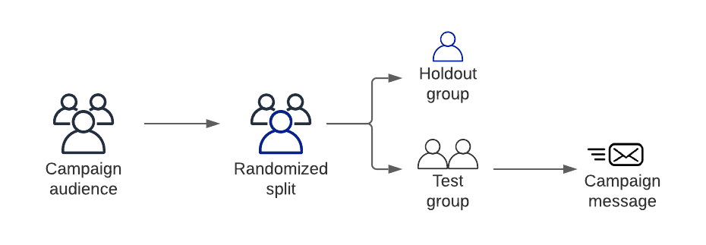
https://medium.com/bluecore-engineering/using-holdout-groups-to-quantify-marketing-campaign-lift-87e6883e3eab
2

Slide 8
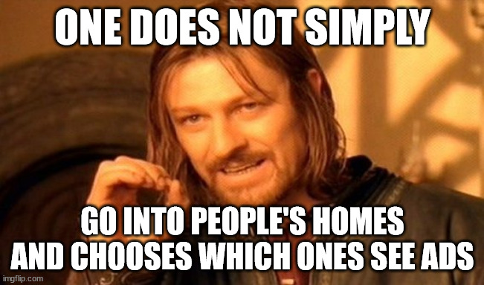
2

Slide 9
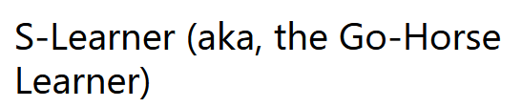

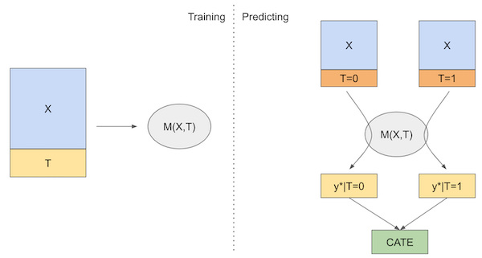

https://matheusfacure.github.io/python-causality-handbook/21-Meta-Learners.html
2
Notes:
TODO Add collaboration context for Hulu

Slide 10
Use the best (available) tool for the job

Slide 11

Live TV + Ads
3

Slide 12





$$×5$$
3

Slide 13

3

Slide 14



?
$$×5$$
3

Slide 15

$$×5$$
Workflows
3

Slide 16
Budget time to get used to your tools

Slide 17
BEFORE
AFTER
SQL
SQL
3

Slide 18
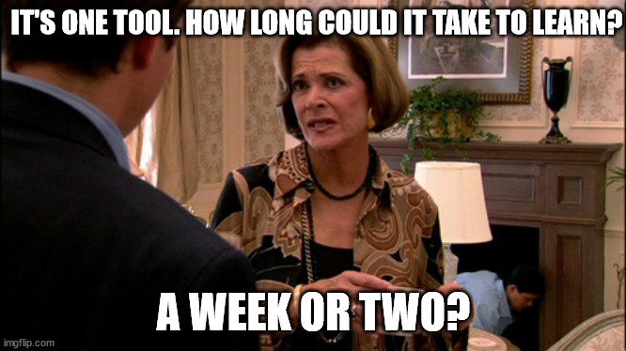
3

Slide 19

2 – 3 Months!
3

Slide 20
Three lessons
Don’t reinvent the wheel, use similar project to start off from
Use not only best tool for the job, but also the best available tool
Budget time to get used to your tools, especially when they are new
3

